Slide 1
The light
Spreading and refraction

Slide 2
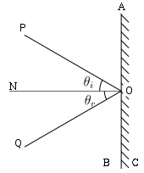
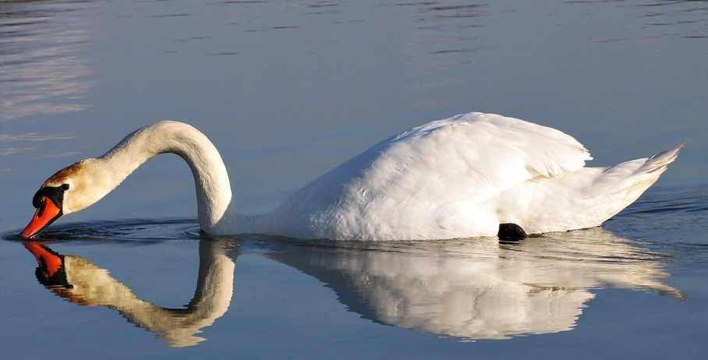
Reflection of the light
Change of direction of spreading light. It occurs on the border of two matters.

Slide 3
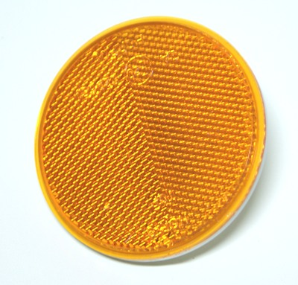
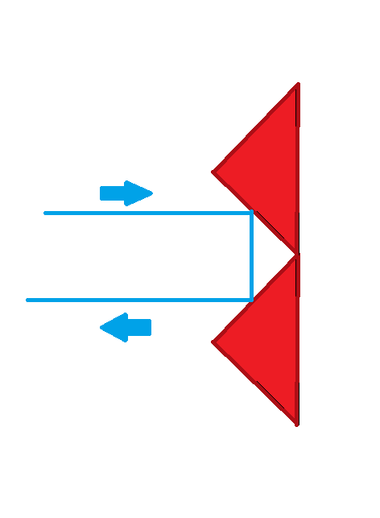
We use this phenomenon in production of reflectors.

Slide 4
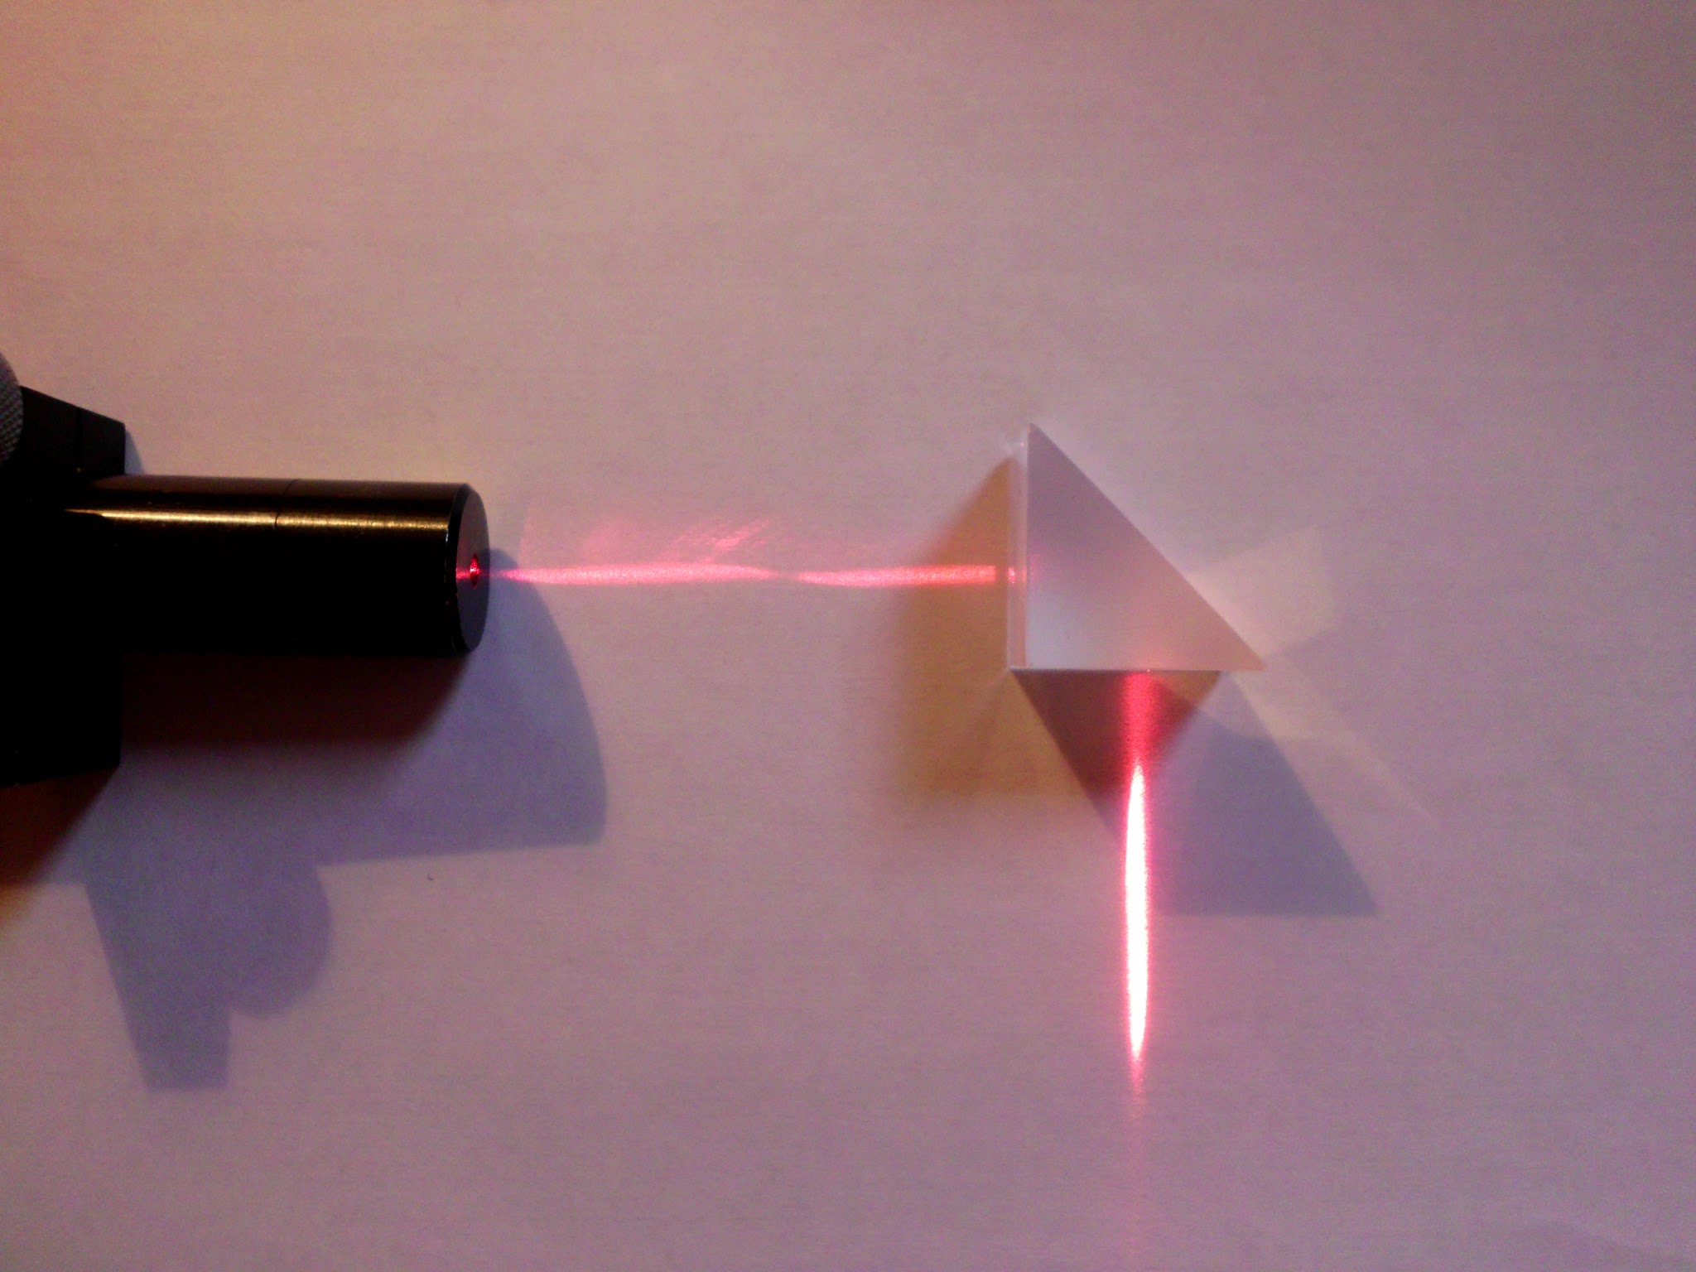
Reflection in the prism.

Slide 5
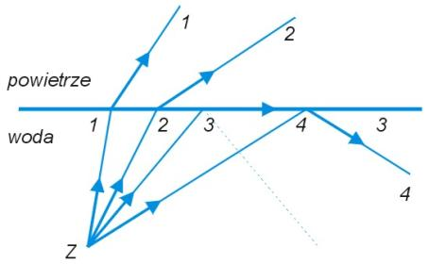

Slide 6
Total interal reflectiom
During reflection a part of the light passes to another matter (glass/water). When we eliminate this transition we talk about total interal reflection.

Slide 7
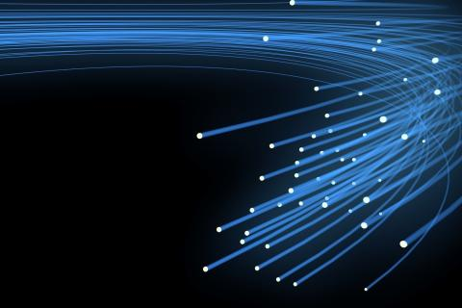
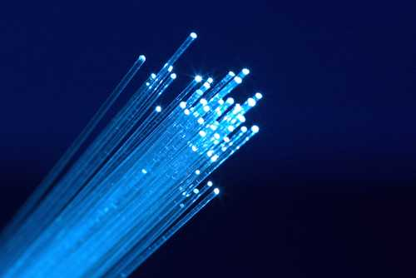
Why it’s useful?
We use this phenomen in optical fibers.
Optical fibers are using to very fast transmission of informations.

Slide 8
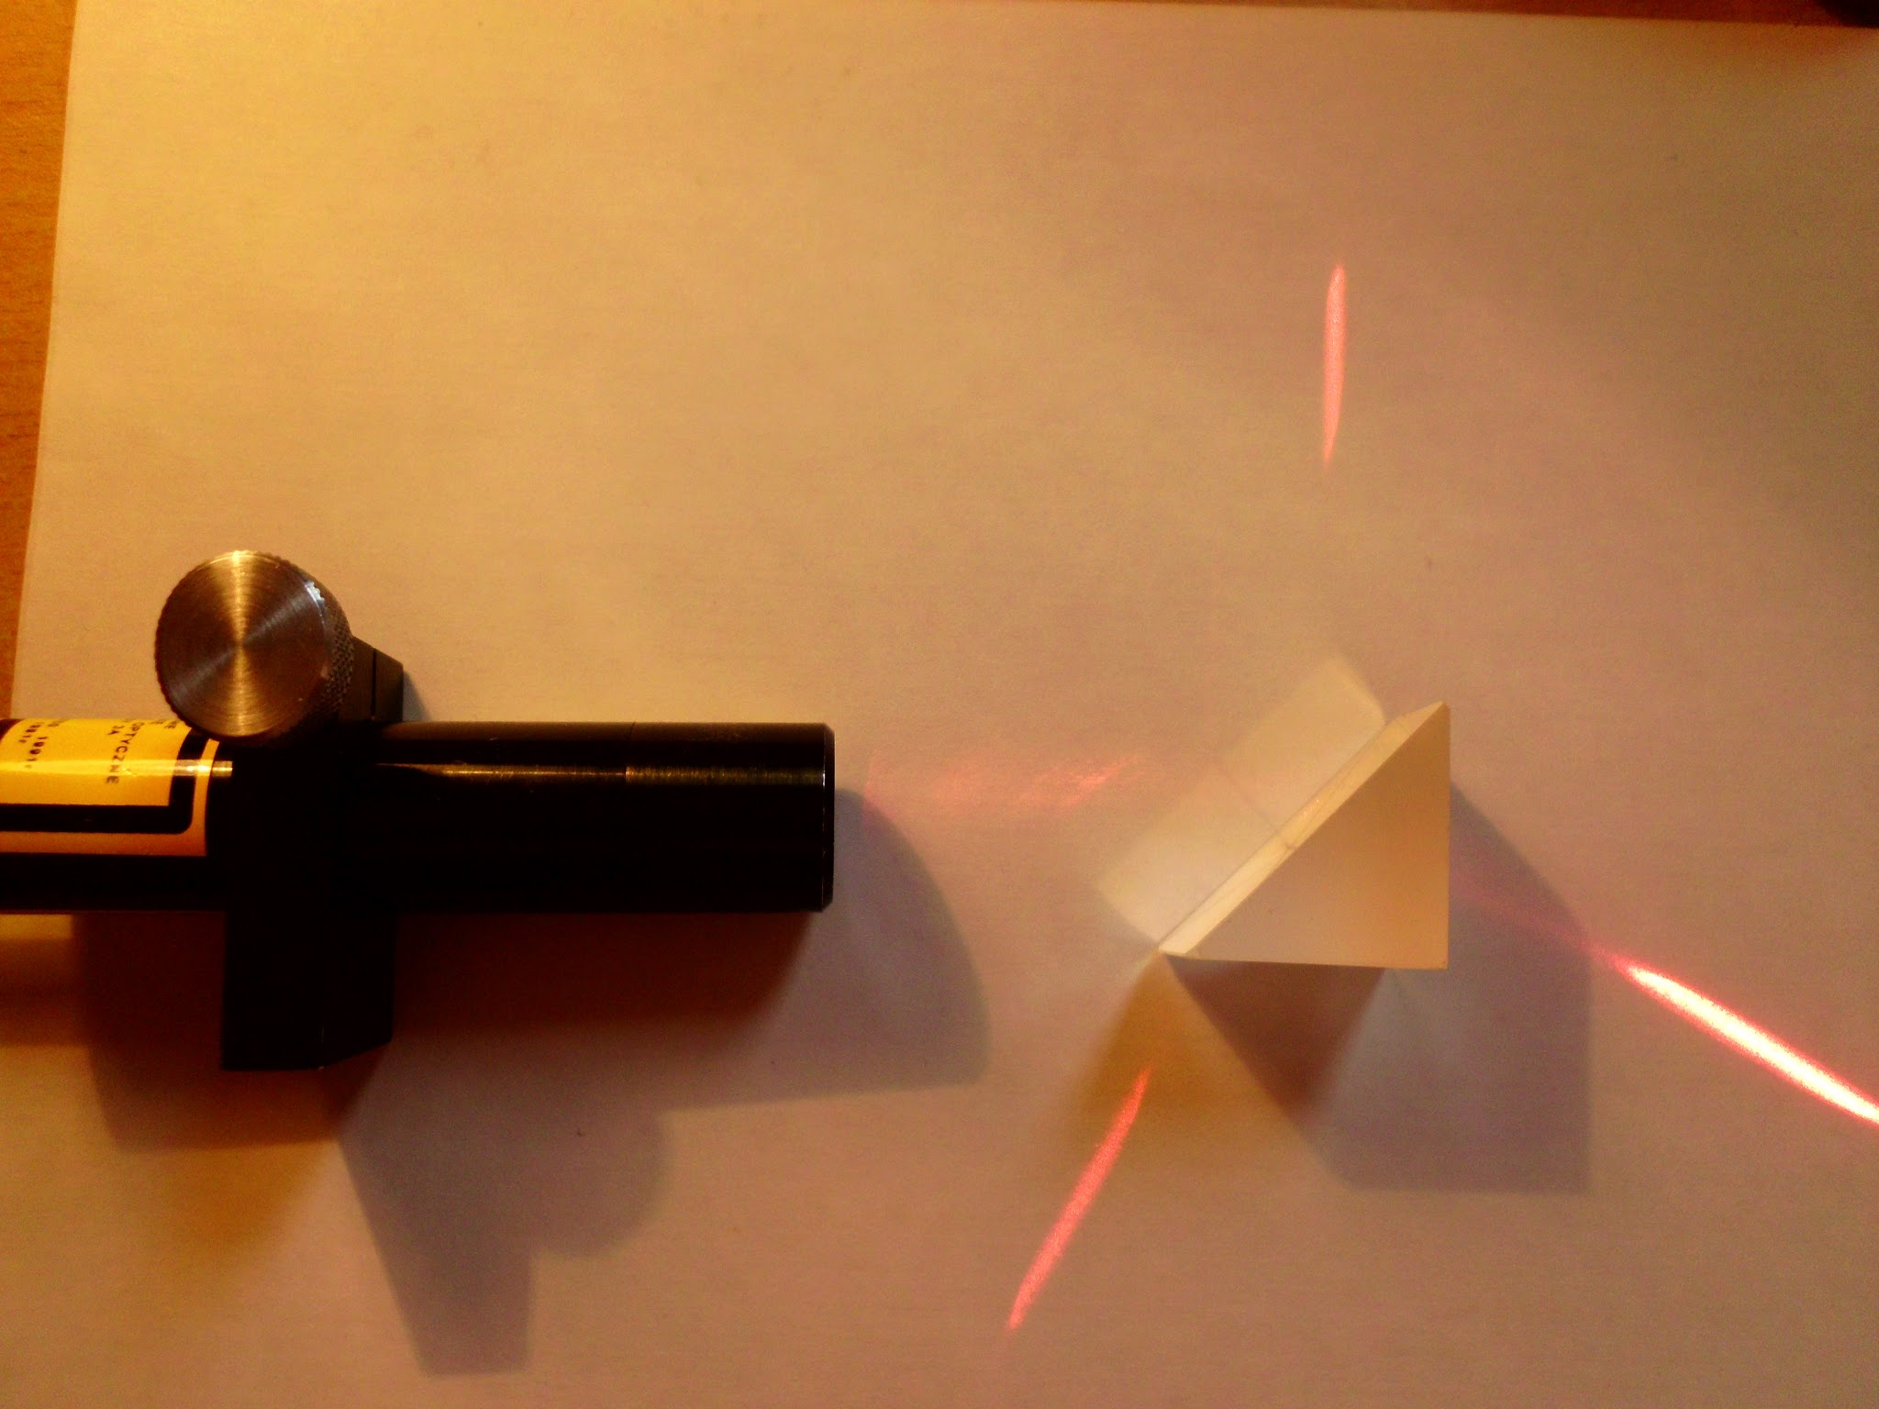
The prism
Diffraction of the light in a prism.

Slide 9
Explanation
We passed light of the laser through the prism. And light refracted.
Light diffracts on the border of two different matters, because speed of diverging light is different. In air light is fast, in water slower and in glass the slowest.

Slide 10
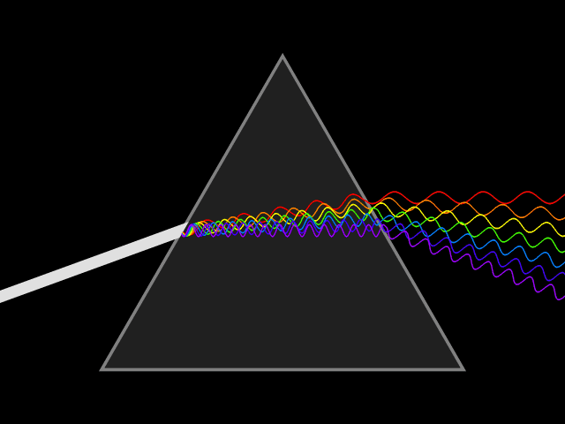
White light

Slide 11
Diffraction
Prism diffracts white light, because speed of spreads of another colors is different. (red light is fastest, and violet light is the slowest)

Slide 12
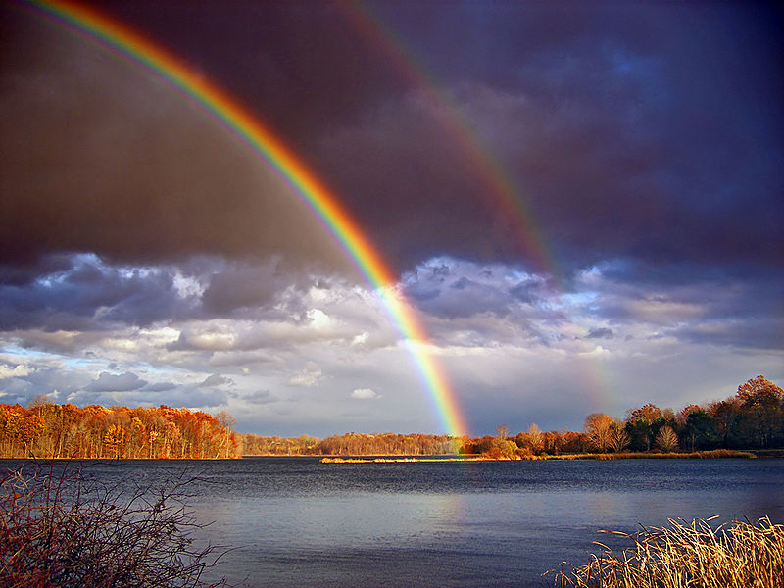
The spreading of light in nature
Rainbow!

Slide 13
Speed of the light
Light is the faster in void.
Speed is about 300 000 km/s.
Distance form Earth to Moon and light’s speed

Slide 14
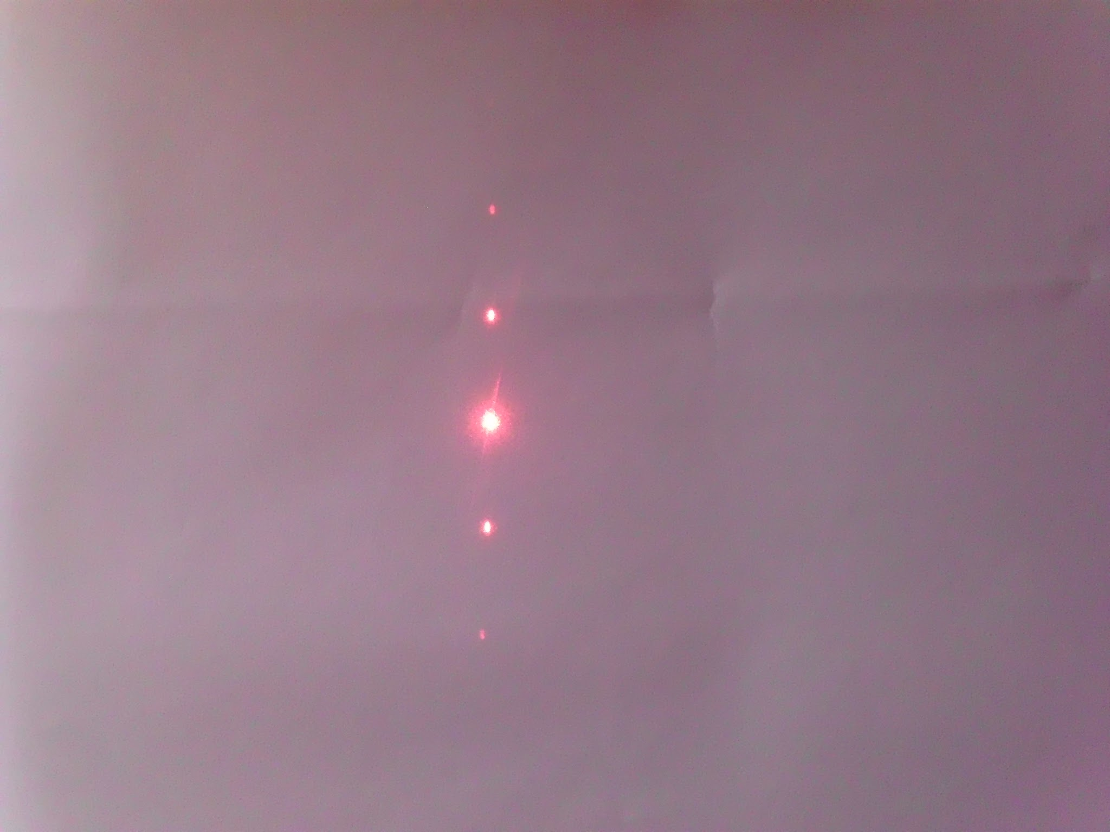
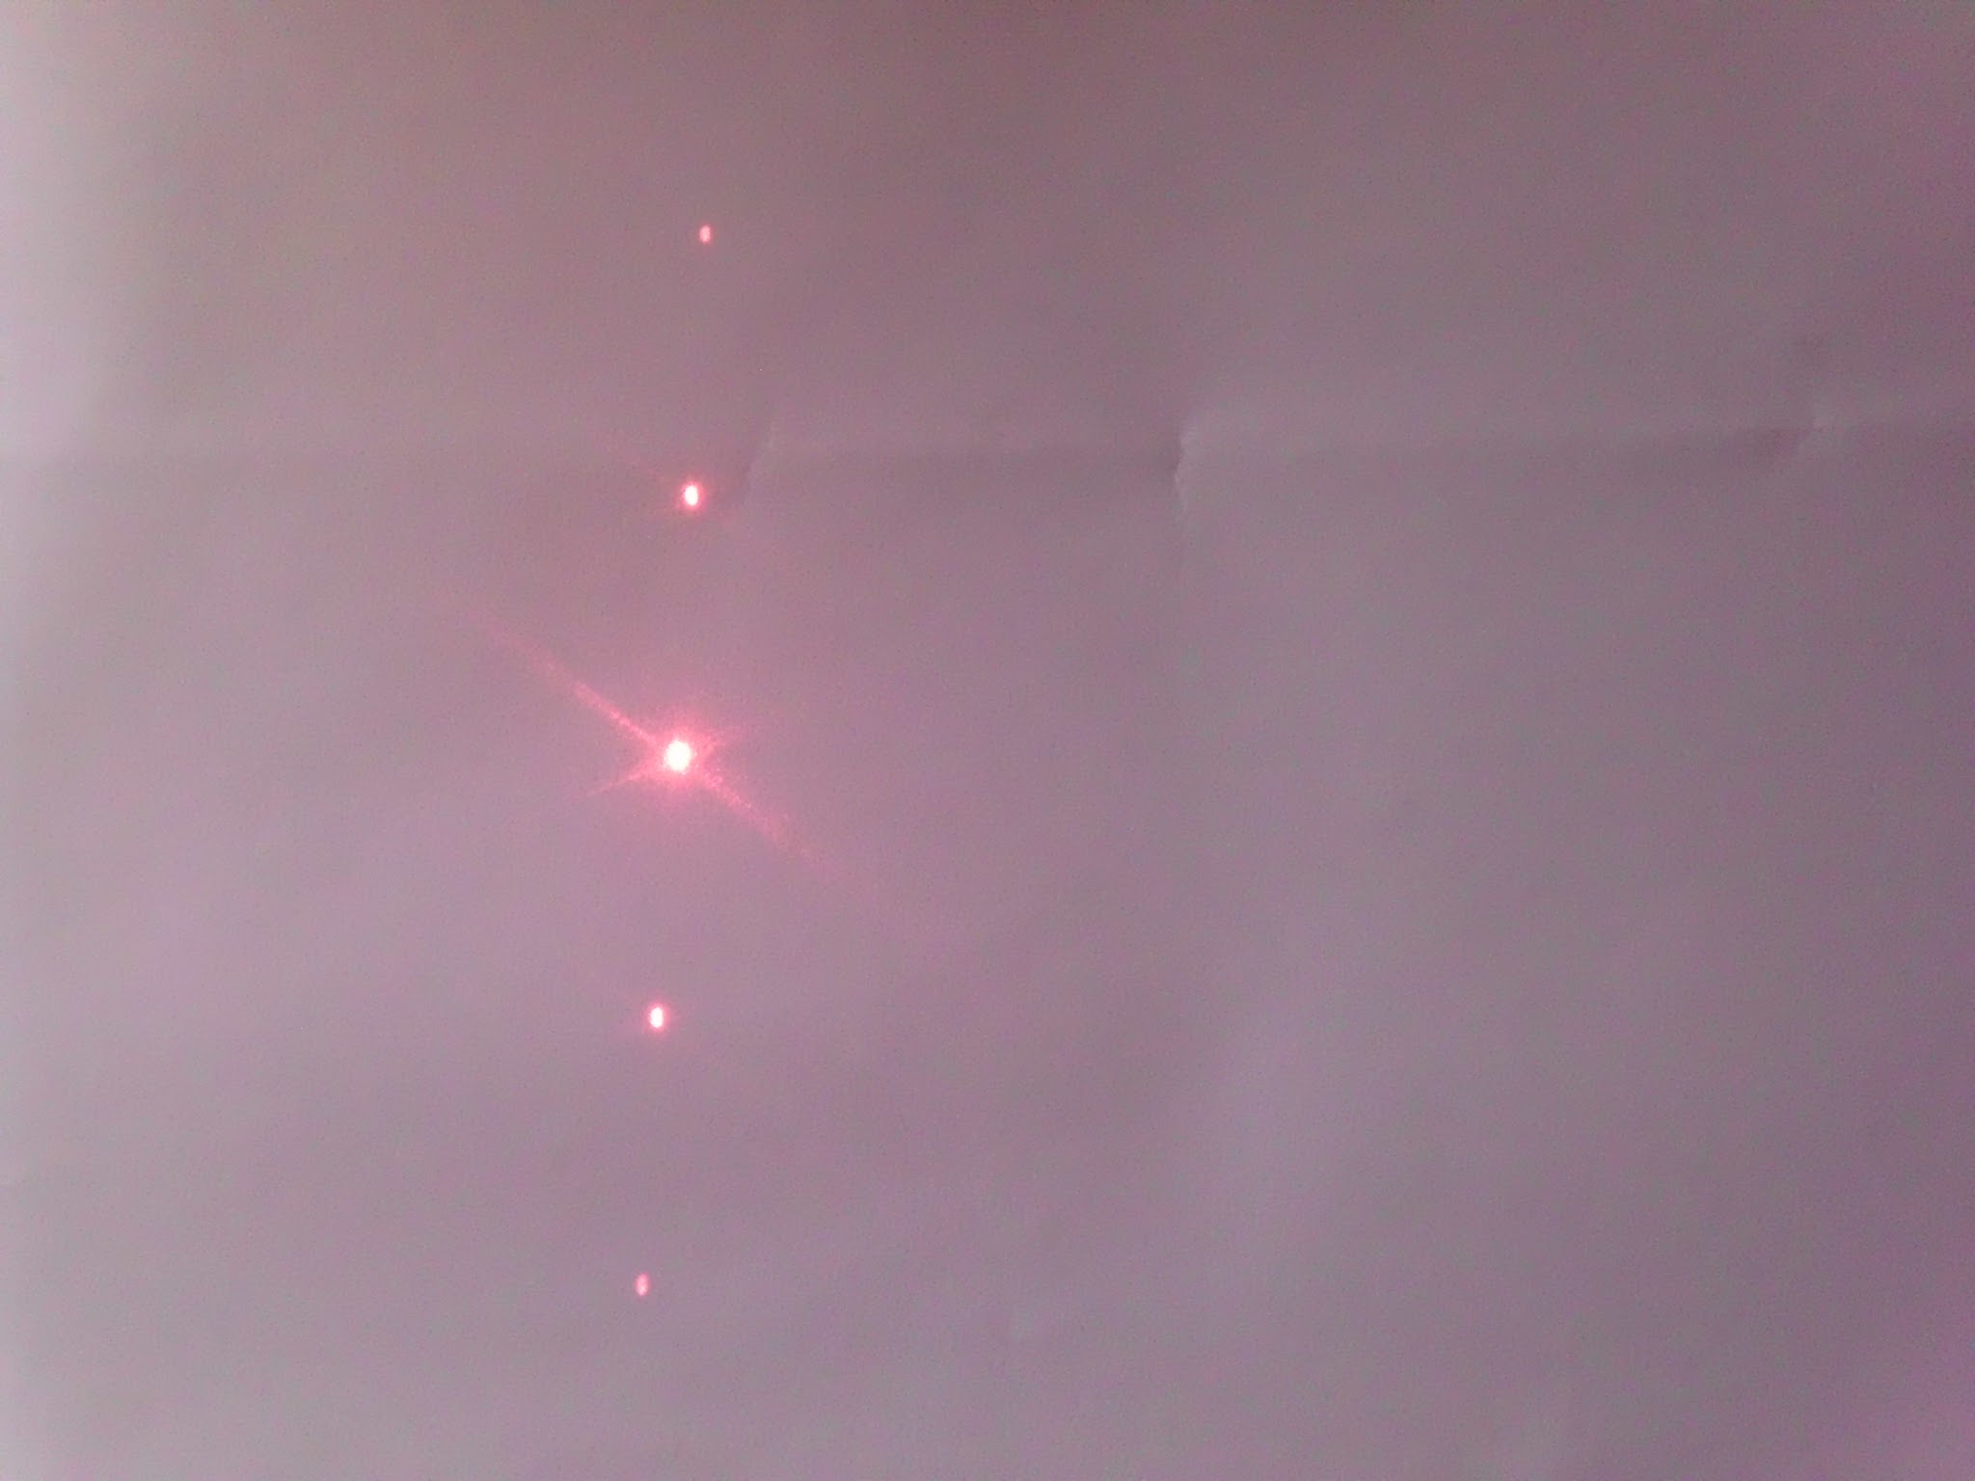
Difraction and Young’s experience
We’re passing the light through two slots or diffraction grating. Light behaves like a wave.

Slide 15
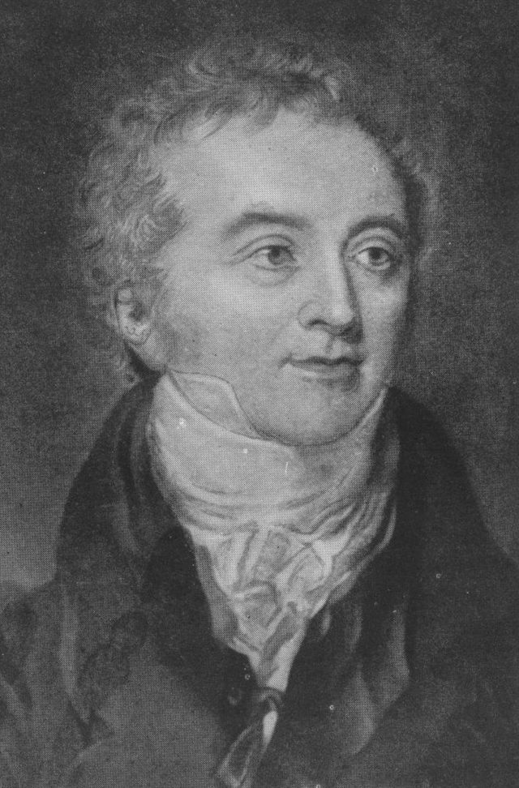
Explanation
We see a series of spots. The waves are interferenting. This phenomenon was studying Thomas Young.

Slide 16
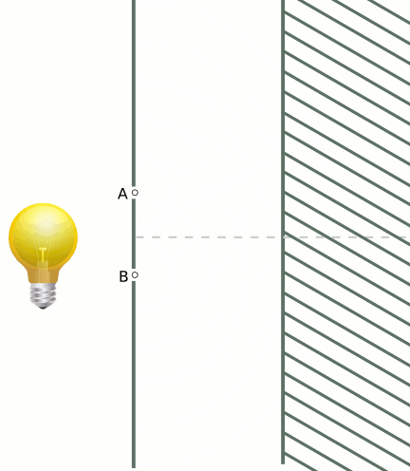

Slide 17
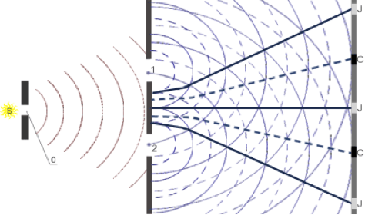
Extinction and reinforcement of waves.

Slide 18
Thanks for Your attention! :)
by J. Kusz

